Slide 1
BloodBridge: Optimizing Lifesaving Resources using AWS services
TEAM MEMBERS
1.MADHUMATHI P
2.MITHULA N
3.MONISHA P
4.NIROSHA R
5.PRIYADHARSHINI S

Slide 2
ABSTRACT
The BloodBridge project seeks to revolutionize blood resource management by leveraging the scalability, security, and real-time data processing capabilities of Amazon Web Services (AWS).
The LifeLink platform connects hospitals, blood banks, and donors to optimize the donation process, inventory management, and emergency blood requests.
The system includes three primary functionalities: Emergency Blood Request, Regular Donor Management, and Blood Bank Inventory Updates.

Slide 3
INTRODUCTION
The BloodBridge project seeks to address the ongoing challenges faced by hospitals, blood banks, and donors in managing blood resources. Blood shortages, particularly for rare blood types, can lead to significant delays in medical treatments and pose serious risks to patients. The LifeLink platform, powered by Amazon Web Services (AWS), aims to streamline the entire blood donation and distribution process, ensuring that critical blood resources are always available when needed most.

Slide 4
Through a combination of real-time data processing, automated workflows, and secure communication between hospitals, donors, and blood banks, LifeLink transforms how blood is requested, donated, and managed.

Slide 5
Disadvantages of Existing Blood Resource Management Systems
Inefficient Inventory Management
Delayed Emergency Response
Limited Donor Engagement and Retention
No Real-Time Data Integration
Poor Matching of Donors to Patients
Lack of Scalability
Limited Communication and Collaboration
Security and Privacy Issues
High Operational Costs
Inflexibility to Meet Changing Demands

Slide 6
ADVANTAGES OF CURRENT SYSTEM
Real-Time Inventory Management
Faster Emergency Response
Automated Donor-Patient Matching
Improved Donor Engagement
Cloud-Based Scalability
Better Coordination and Communication
Secure Data Management
Cost Efficiency
Proactive Resource Management

Slide 7
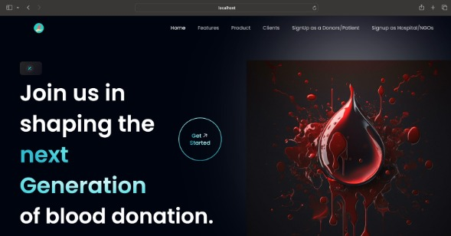
SAMPLE IMAGE

Slide 8
REFERENCE
AWS Documentation References:
- AWS Lambda
- Amazon SNS (Simple Notification Service)
- Amazon DynamoDB
- Amazon API Gateway
- AWS S3 (Simple Storage Service)
- AWS IAM (Identity and Access Management)
- AWS CloudFormation
- AWS VPC (Virtual Private Cloud)

Slide 9
CONCLUSION
The BloodBridge system uses AWS cloud technology to create a secure, scalable, and efficient platform for managing blood donations. It improves the speed and accuracy of blood requests, donor management, and inventory tracking, helping save lives. With future upgrades in AI, mobile features, and global expansion, BloodBridge can further enhance the blood supply chain and support medical emergencies worldwide.

